Slide 1
Step 2 – Todo UI
Building Stateful Widgets and Dynamic UI

Slide 2
Stateful Widgets
Reviewing the core counter app code, we can see that when we want the internal state (and therefore the view) to refresh we call a setState() function.
This function tells flutter to reload the UI build methods and determine any changes it needs to make.
However, let's say we have a list of items that we want to update, the UI will need to respond to an additional widget if a new item is added.
To do this we use a builder to infer the collection of widgets using the number of items.

Slide 3
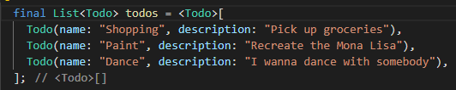
Create a list
Inside the _TodoHomePageState class, add a final list of todos like this:
This will give us some temporary/fake data to work with in our application.
Now we can start building our UI using an ItemBuilder

Slide 4
ListView
In the body of the scaffold, add a new centre widget.
In its child we're going to create a listview by dynamically calling the ListView.builder() function.
This takes a few parameters that will allow us to generate a template style widget.
For now, we're going to just output the list.
The builder function takes a few options, but the once we're going to add are the itemCount and itemBuilder.

Slide 5
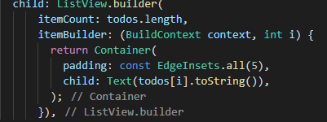
itemBuilder
ItemCount: tells the ListView.Builder() how many iterations
Inside the itemBuilder parameter, we need to pass a function that flutter uses to build the UI elements. It returns the widgets by looping over a collection.
ItemBuilder function looks like this:
Each Widget List Item looks like this.
Fetching data from dynamic list

Slide 6
Exercise – Customise View
Update the returned widget by combining other widgets to create a visually pleasing UI for each element.
Feel free to utilise the properties of the Todo class and position the information appropriately within the widget structure.
Suggested widgets:
BoxDecoration
BoxShadow
Colors
Margin/Padding: EdgeInsets.all() / EdgeInsets.fromLTRB()
Also add additional styling to the application from the scaffolding.

